Slide 1
Chapter 10
Management of wellness amenities/facilities and upgrading them in food service, hospitality and tourism businesses
Dr. Bendegul Okumus
Heather Linton Kelly

Slide 2
Learning Outcomes
Discuss the case study of Finger Lakes Region, New York
Define and discuss wellness destinations, facilities, and amenities
Categorize core resources and competencies that a wellness destination should have
Define and discuss management of wellness destinations
Define and discuss development of facilities and amenities in wellness destinations

Slide 3
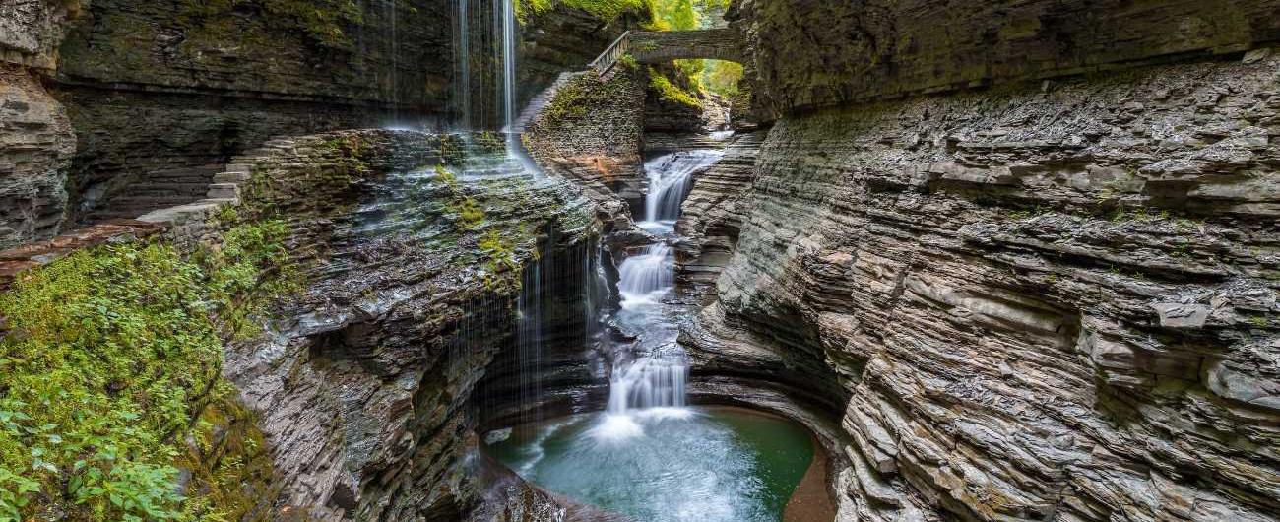
Case Study: Finger Lakes, New York
Click the following link to learn more: https://www.facebook.com/FingerLakesTourismAlliance/videos/315091822719634/

Slide 4
Wellness Destinations, Facilities, and Amenities
Destination Management Organization (DMO) – The leading organizational entity which may encompass the various authorities, stakeholders, and professionals and facilitates partnerships towards a collective destination vision.
  DMOs coordinate efforts within each destination and between the destination and the rest of the world
DMO
Marketing → Management

Slide 5
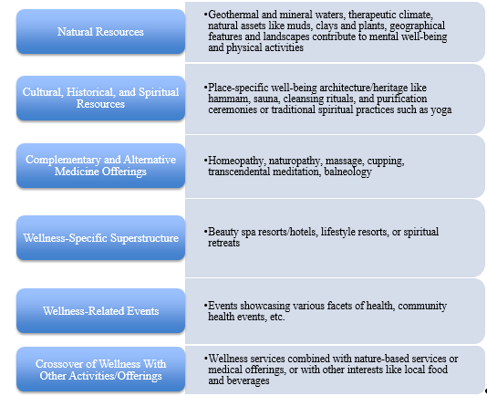
Wellness Destination Core Resources & Competencies
Wellness Destination Core
Resources and Competencies
that comprise a wellness
destination as described by
Voigt and Pforr

Slide 6

Wellness Destination Management and Development
Destination Management – The coordinated management of all the elements that make up a tourism destination (attractions, amenities, access, marketing and pricing)

Slide 7
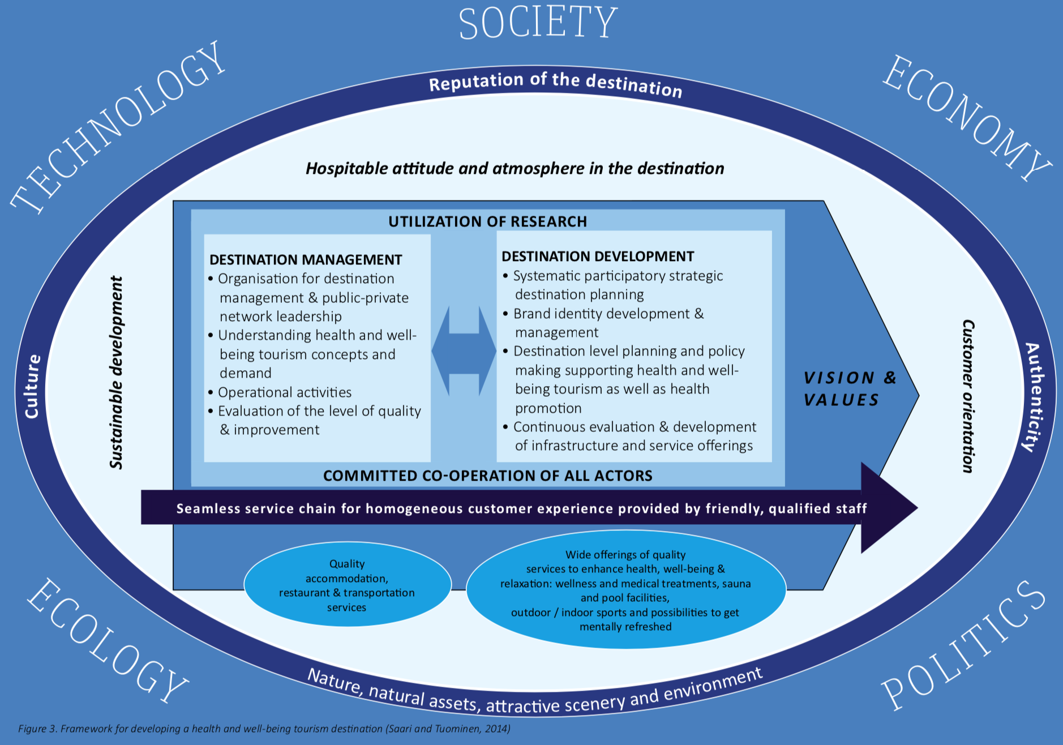
Components of developing a health and wellness destination

Slide 8

Wellness Destination Management – Macro Factors

Slide 9
Wellness Destination Development
Strategic destination planning in a systematic way that incorporates all relevant parties
Developing and managing the destination’s brand identity
Planning and policy making at a destination level to support and promote wellness tourism
Continually evaluating and leading the development of infrastructure and service offerings

Slide 10
Maintaining a Destination for Future Generations
Take action to eliminate pollution and any destroying of nature, so guests can enjoy easily accessible intact natural areas
Incorporate natural resources into the destination’s product offering
Offer wellness treatments based on indigenous or local health and wellbeing traditions
Ensure food and beverages that are part of the wellness product are organic and/or locally sourced
Highlight the local culture through events, museums, and sites made accessible to visitors
Live up to expectations created by the destination’s marketing campaigns
Base the destination’s overall reputation on health and wellness

Slide 11
Wellness Facilities and Amenities
Superstructure – An umbrella term for facilities and services created especially for tourists, for example, hotels, restaurants, transportation facilities, recreation facilities, and built attractions
  High-quality accommodations
  Restaurants
  Transportation services
  Wide offering of high-quality services to enhance health, well-being, and relaxation
Wellness facilities and amenities may be publicly or privately owned/managed

Slide 12
Summary
The Finger Lakes Region of New York State has become a wellness haven.
Destination Management Organization (DMO) is “the leading organizational entity which may encompass the various authorities, stakeholders, and professionals and facilitates partnerships towards a collective destination vision.”
The M in DMO has transitioned from “marketing” to “management”
The core resources and competencies that comprise a wellness destination according to Voigt and Pforr are natural resources, cultural, historical, and spiritual resources, complementary and alternative medicine offering, wellness-specific superstructure, wellness-related events, and crossover of wellness with other activities/offerings.

Slide 13
Summary
Destination management includes the following dimensions: coordinating public and private network leadership and actors, understanding the past, current, and future health and well-being tourism concepts and demand, operational activities throughout the destination network, and evaluating the quality of the product offered by the destination and monitoring its improvement
The five macro-level factors that can affect the competitiveness and success of a destination include: social/cultural, economy, political/legal, ecology/environment, and technology.
Destination management is the coordinated management of all elements that make up a tourism destination

Slide 14
Summary
Destination development takes place in four dimensions: strategic destination planning in a systematic way that incorporate all relevant parties, developing and managing the destination’s brand identity, planning and policy making at a destination level to support and promote wellness tourism, and continually evaluating and leading the development of infrastructure and service offerings.
Maintaining a destination for future generations is important. Some ways to maintain a destination include eliminating pollution, incorporating natural resources into product offerings, highlighting local culture, and many more.

Slide 15
Summary
DMOs can help improve wellness tourism offerings by ensuring sustainability, strengthening institutional governance, identifying gaps, building a tourism culture in a destination, and many more.
Superstructure is an umbrella terms for faculties and services created especially for tourists
Wellness destination development is the process of systematically and continuously planning, developing, managing, evaluating, and leading a destination’s brand identity as it relates to wellness tourism.

